Slide 1
Gateway Basic and OTA
Jim Lin
Dec 10, 2019

Slide 2
Agenda
Hands-on : Control Zigbee Devices with MQTT Clients
Hands-on : OTA
Q & A

Slide 3


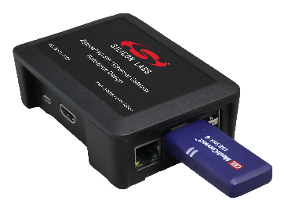

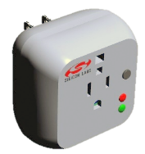
Gateway Overview
Zigbee Gateway
Zigbee
MQTT/CoAP
Zigbee Gateway translate Zigbee messages and MQTT messages from each other.

Slide 4
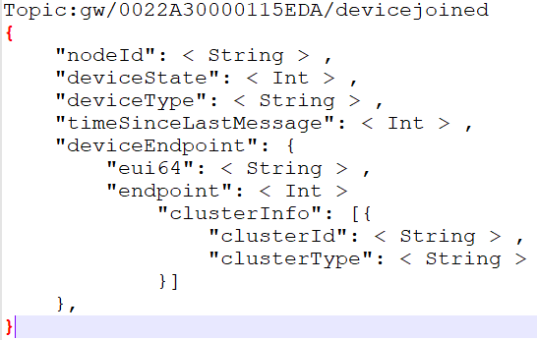
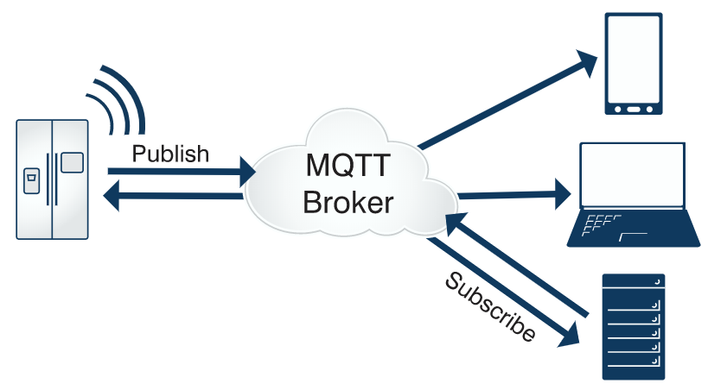
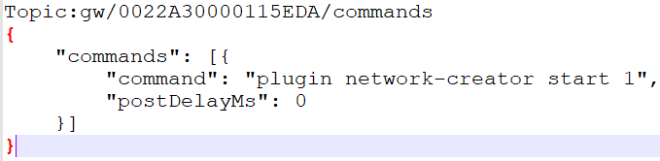
MQTT
Publish/Subscribe
Topic
Represents a message type
Also include the address info
Payload
Message content. (xml or JSON)
Notes:
Broker

Slide 5
MQTT Hands-on
Z3Gateway
Z3GatewayHost.exe
MQTT
Broker
MQTT Client
Zigbee Application
MQTT
Client
Host
UART/SPI
Mosquitto Broker
MQTTBox
Network
MAC
PHY
EFR32
ncp.s37
bootloader-xmodem-uart.s37
Zigbee
Light
Z3LightSoc.s37
bootloader-storage-internal-single-combined-Z3light.s37

Slide 6
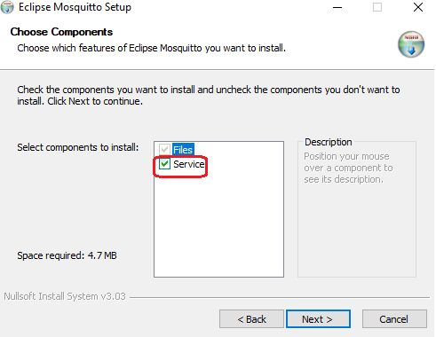
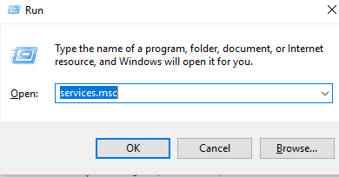
Hands-on: Install MQTT Broker --- Mosquitto
mosquitto-1.6.7-install-windows-x64.exe
Make sure the service “Mosquitto Broker” is running
“win+R” then input “services.msc” to start the service manager, then check the service state
If it’s not running, right click and select “start”

Slide 7
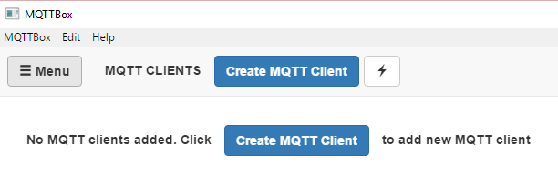
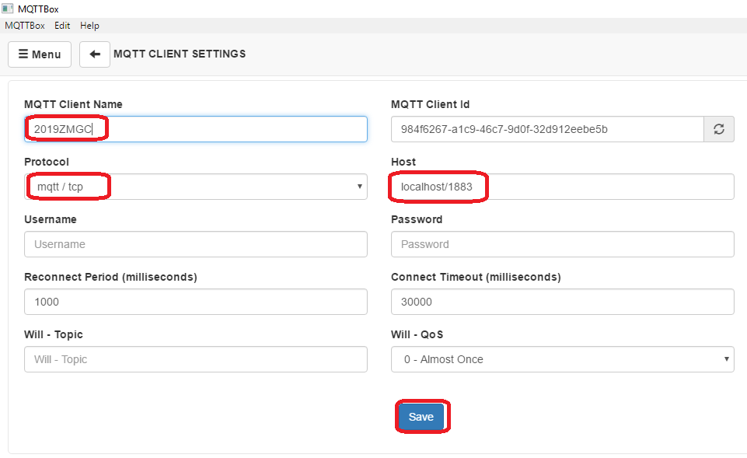
Hands-on: MQTT Client

Slide 8
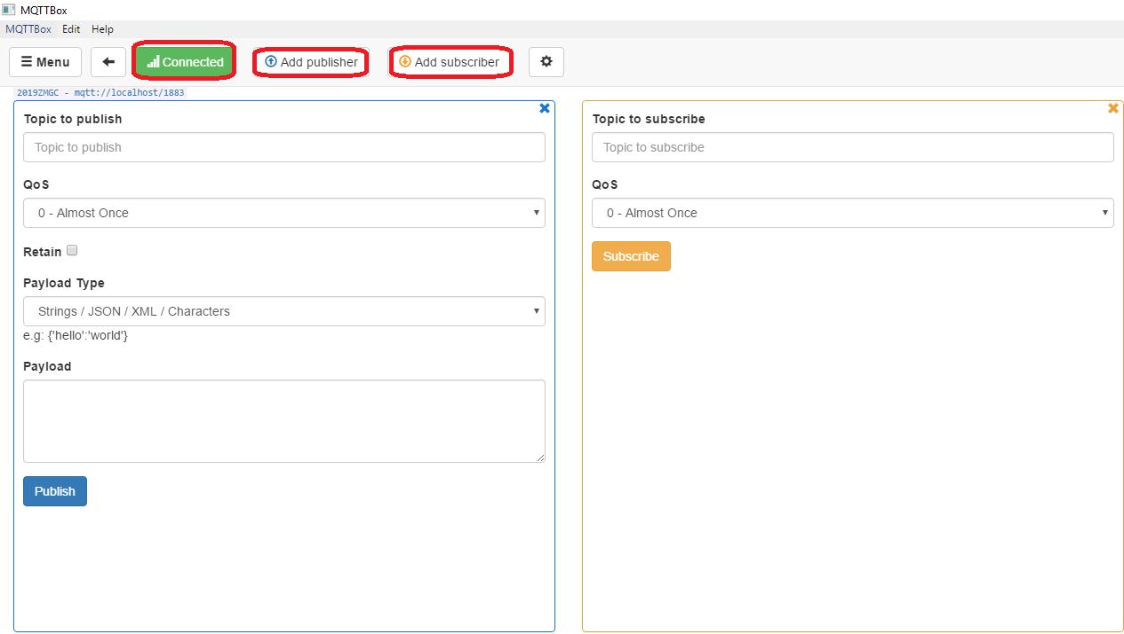
Hands-on: MQTT Client

Slide 9
MQTT Client on Mobile Phone
IOS
https://github.com/mqtt/mqtt.github.io/wiki/mqtt_on_ios
Android
https://github.com/mqtt/mqtt.github.io/wiki/mqtt_on_the_android_platform

Slide 10
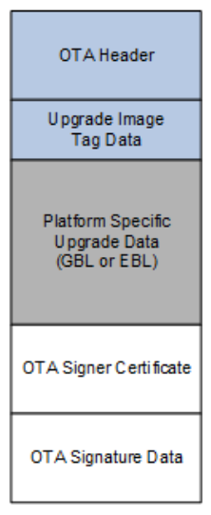
OTA Overview
V200
Build/exe/ota-files/Client.ota
Z3GatewayHost.exe
New image file will be transferred from server to client.
Client will split the GBL file out and save it to storage.
Z3Gateway
New image
Zigbee Application
MQTT
Client
SPI Flash
Host
OTA Client
UART/SPI
Network
MAC
PHY
EFR32
ncp.s37
bootloader-xmodem-uart.s37
V100 Client.s37
bootloader-storage-spiflash-single.s37

Slide 11
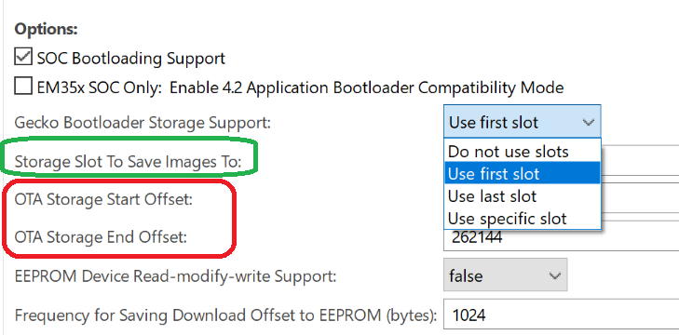
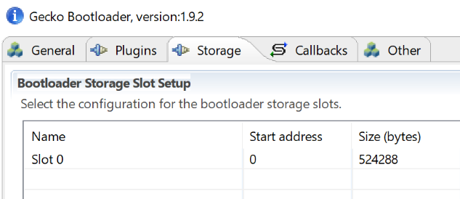
OTA Storage Setting
OTA file storage is implemented by bootloader. (Internal storage or SPI storage)
Plugin “OTA Simple Storage EEPROM Driver ”
Using slot-manager
Using address offset

Slide 12
OTA Procedure
OTA Server
OTA Client
Find OTA file according to
Hardware version
Image type
Manufacture ID
Firmware version
Query Next Image Request
Query Next Image Response
Erase the storage and prepare to receive new image
Image Block Request
Image Block Response
……
Save received data
Image Block Request
Image Block Response
Upgrade End Request
Check if received image is valid
Upgrade End Response
Reset and bootload the new image

Slide 13
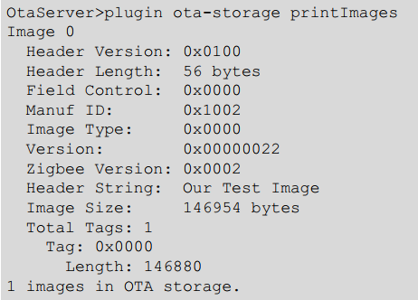
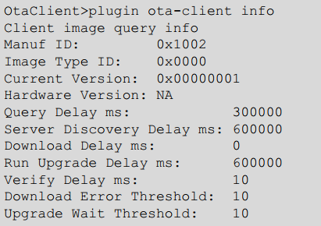
Commands
Show OTA images on server
Show version on client

Slide 14
Q&A
Q&A

Slide 15
Thank you!
Notes:
Thanks

